Slide 1


Azure Kubernetes Service
Accelerate Growth on Cloud

Slide 2
Agenda
DEMO
Load Balancer and External Name
Azure Virtual Networks
Services for Network configuration
Cluster IP and Node Port

Slide 3
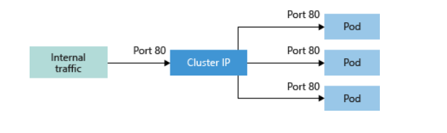
SERVICES
● To simplify the network configuration for application workloads, Kubernetes uses Services to logically group a set of pods together and provide network connectivity.
Cluster IP
Creates an internal IP address for use within the AKS cluster. Good for internal-only applications that support other workloads within the cluster.
Copyright (c) 2019. Blazeclan Technologies Pvt. Ltd.

Slide 4
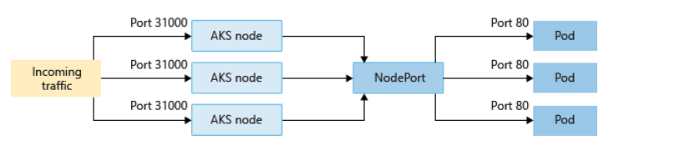
Services
● NODEPORT
Creates a port mapping on the underlying node that allows the application to be accessed directly with the node IP address and port.
Copyright (c) 2019. Blazeclan Technologies Pvt. Ltd.

Slide 5
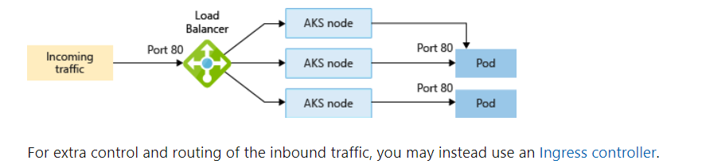
SERVICES LB
LOAD BALANCER
Creates an Azure load balancer resource, configures an external IP address and connects the requested pods to the load balancer backend pool. To allow customers' traffic to reach the application, load balancing rules are created on the desired ports.
Copyright (c) 2019. Blazeclan Technologies Pvt. Ltd.

Slide 6
SERVICES
EXTERNAL NAME
Creates a specific DNS entry for easier application access.
Either the load balancers and services’ IP addresses can be dynamically assigned, or you can specify an existing static IP address. You can assign both internal and external static IP addresses. Existing static IP addresses are often tied to a DNS entry.
You can create both internal and external load balancers. Internal load balancers are only assigned a private IP address, so they can't be accessed from the Internet.
Copyright (c) 2019. Blazeclan Technologies Pvt. Ltd.

Slide 7
SERVICES
EXTERNAL NAME
Creates a specific DNS entry for easier application access.
Either the load balancers and services’ IP addresses can be dynamically assigned, or you can specify an existing static IP address. You can assign both internal and external static IP addresses. Existing static IP addresses are often tied to a DNS entry.
You can create both internal and external load balancers. Internal load balancers are only assigned a private IP address, so they can't be accessed from the Internet.
Copyright (c) 2019. Blazeclan Technologies Pvt. Ltd.

Slide 8
AKS VIRTUAL NETWORKS
In AKS, you can deploy a cluster that uses one of the following two network models:
Kubenet networking
The network resources are typically created and configured as the AKS cluster is deployed.
Azure Container Networking Interface (CNI) networking
The AKS cluster is connected to existing virtual network resources and configurations.
Copyright (c) 2019. Blazeclan Technologies Pvt. Ltd.

Slide 9
AKS VIRTUAL NETWORKS
Kubenet (basic) networking
The kubenet networking option is the default configuration for AKS cluster creation.
With kubenet:
Nodes receive an IP address from the Azure virtual network subnet.
Pods receive an IP address from a logically different address space than the nodes' Azure virtual network subnet.
Network address translation (NAT) is then configured so that the pods can reach resources on the Azure virtual network.
The source IP address of the traffic is translated to the node's primary IP address.
Copyright (c) 2019. Blazeclan Technologies Pvt. Ltd.

Slide 10
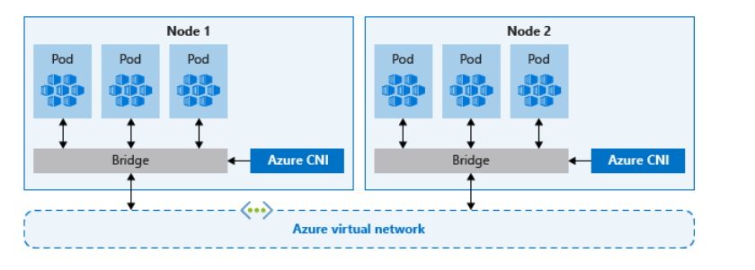
AKS VIRTUAL NETWORKS
Azure CNI (advanced) networking
With Azure CNI, every pod gets an IP address from the subnet and can be accessed directly.
These IP addresses must be planned in advance and unique across your network space.
Each node has a configuration parameter for the maximum number of pods it supports.
The equivalent number of IP addresses per node are then reserved up front.
Unlike kubenet, traffic to endpoints in the same virtual network isn't NAT'd to the node's primary IP. The source address for traffic inside the virtual network is the pod IP. Traffic that's external to the virtual network still NATs to the node's primary IP.
Copyright (c) 2019. Blazeclan Technologies Pvt. Ltd.

Slide 11
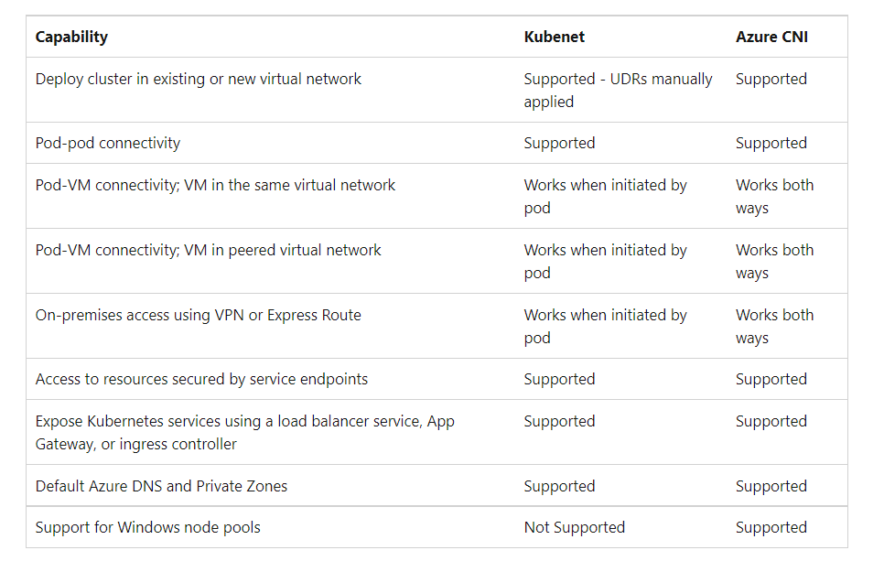
KUBENET / Azure CNI
Copyright (c) 2019. Blazeclan Technologies Pvt. Ltd.

Slide 12
DEMO

Slide 13

thank you
Notes:
Do Not edit this Slide, This is Thank you in motion

